Slide 1
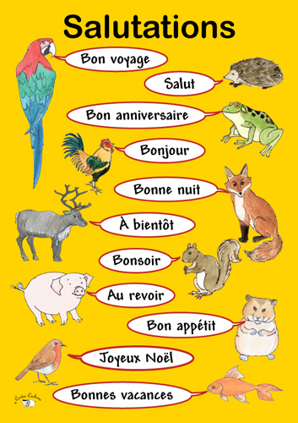
Les salutations

Slide 2
In this lesson you will learn to:
Greet someone at different times of day in French
Repeat the same greeting to the speaker
Cultural differences in the way people greet each other in French-speaking countries
Various ways to say good-bye

Slide 3
A general “hello” in French is “Salut!”

Slide 4
“Good morning” is “Bonjour!”…

Slide 5
There is no separate expression for “good afternoon”. Instead the French say “good evening”, which is “Bonsoir”…

Slide 6
Before going to bed, we say “Bonne nuit!”…

Slide 7
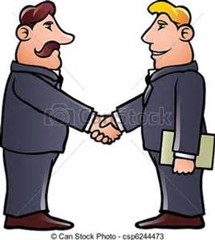
Cultural Note: In French you repeat the same expression back to the person who says it….
Jean-Luc: Bonjour Yves!
Yves: Bonjour Jean-Luc!

Slide 8
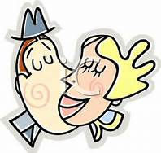
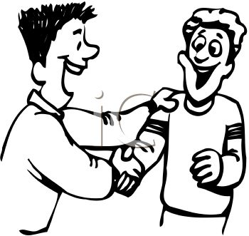
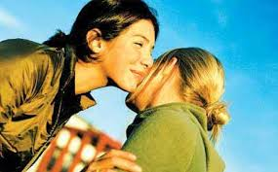
Cultural Tip 2: Friends and relatives either hug or kiss each other lightly on the cheeks, about six inches from the mouth.
Male friends/relatives Male/Female Friends Female/Female

Slide 9
To say goodbye in formal situations, you say “Adieu” or “Au revoir”.

Slide 10
If you expect to see each other soon, you can say… “À bientôt!”

Slide 11
You can also say “À plus tard!” if you will see each other a little later.

Slide 12
If you will see each other tomorrow, you can say “À demain!”

Slide 13
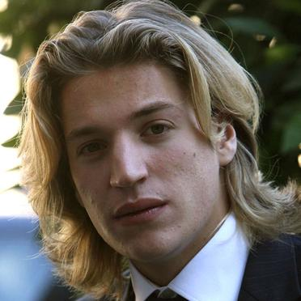
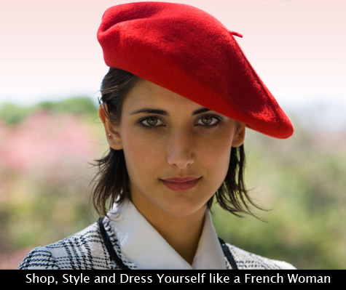
Comment t’appelles-tu? Tu t’appelles comment?
Je m’appelle Marie-Claire. Enchantée.
Je m’appelle Jean-Luc, et toi?

Slide 14
Comment ça va?
Ça va bien, merci. Et toi?

