Slide 1
Los saludos

Slide 2
In this lesson you will learn to:
Greet someone at different times of day in Spanish
Repeat the same greeting to the speaker
Cultural differences in the way people greet each other in Spanish-speaking countries
Various ways to say good-bye

Slide 3
A general “hello” in Spanish is….

Slide 4
“Good morning” is “Buenos Días”…

Slide 5
“Good afternoon” is “Buenas Tardes”…

Slide 6
After nightfall, we say “Buenas Noches”…

Slide 7
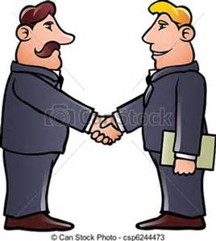
Cultural Note: In Spanish you repeat the same expression back to the person who says it….
Carlos: Hola, Juan. ¡Buenos días!
Juan: Hola, Carlos. ¡Buenos días!

Slide 8
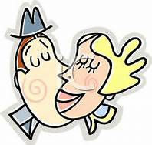
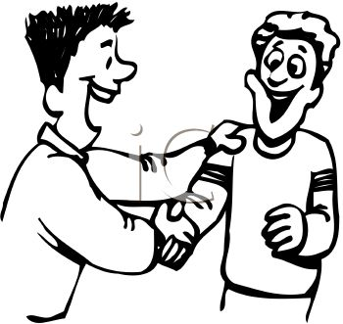
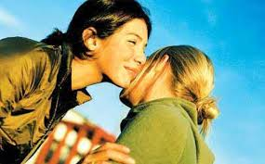
Cultural Tip 2: Friends and relatives either hug or kiss each other lightly on the cheeks, about six inches from the mouth (man and a women, two women).
Male friends/relatives Male/Female Friends Female/Female

Slide 9
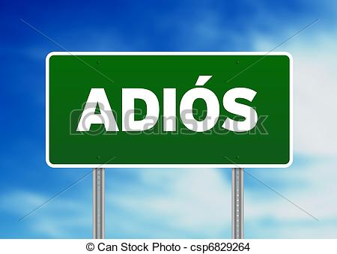
To say goodbye in formal situations, you say “Adiós”.

Slide 10
If you expect to see each other soon, you can say… “Hasta luego”

Slide 11
You can also say “Hasta pronto” if you will see each other very soon.

Slide 12
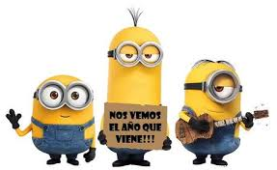
If you are being informal, you can also say “nos vemos”.

Slide 13
…or you can say “cuidate” (“take care”)

Slide 14
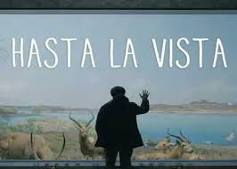
If you don’t know exactly when you will see each other, you can say “hasta la vista” (“until next time”)

Slide 15
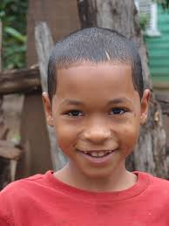
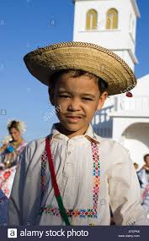
¿Cómo te llamas? Me llamo….
Me llamo Ricardo.
¡Encantado!
Me llamo Paco. ¿Y tú?

Slide 16
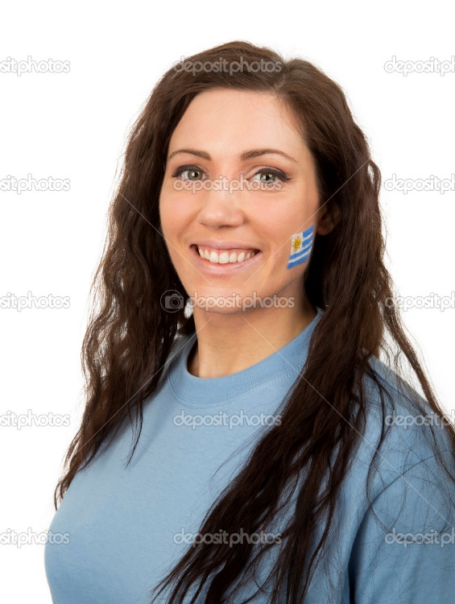
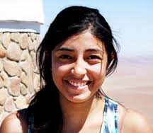
¿ Cómo estás? Estoy muy bien gracias.
Estoy muy bien, gracias. ¿ Y tú?
¿ Cómo estás?

